Slide 1
TRANSACTIONS
‹#›

Slide 2
WHY TRANSACTIONS?
Database systems are normally being accessed by many users or processes at the same time.
Unlike OS, which support interaction of processes, a DMBS needs to keep processes from troublesome interactions.
‹#›

Slide 3
EXAMPLE: BAD INTERACTION
You and your partner each take $100 from different ATM’s at about the same time.
The DBMS better make sure one account deduction doesn’t get lost.
Compare: An OS allows two people to edit a document at the same time. If both write, then changes made by one of them are lost.
‹#›

Slide 4
TRANSACTIONS
Transaction = process involving database queries and/or modification.
Normally with some strong properties regarding concurrency.
Formed in SQL from single statements or explicit programmer control.
‹#›

Slide 5
ACID TRANSACTIONS
ACID transactions are:
Atomic : Whole transaction or none is done.
Consistent : Database constraints preserved.
Isolated : It appears to the user as if only one process executes at a time.
Durable : Effects of a process survive a crash.
Optional: weaker forms of transactions are often supported as well.
‹#›
Notes:
Atomic ATM example : enter card, login to system (pin), balance is checked, amount is deducted, amount handed over to the user and card is given to user
Isolated ATM example … let say entire class is taking out money from MCB ATM and the transaction should appear isolated
Durable AtM example: amount is deducted from acount and machine OS crash somehow and now it should know that the money is not yet given to the user …rollback
‹#›

Slide 6
COMMIT
The SQL statement COMMIT causes a transaction to complete.
It’s database modifications are now permanent in the database.
‹#›

Slide 7
ROLLBACK
The SQL statement ROLLBACK also causes the transaction to end, but by aborting.
No effects on the database.
Failures like division by 0 or a constraint violation can also cause rollback, even if the programmer does not request it.
‹#›

Slide 8
EXAMPLE: INTERACTING PROCESSES
Consider a relation Sells(shop, item, price)
Let Ahmad sells Sprite for Rs12.50 and Pizza Slize for Rs 35.00.
Tania is querying Sells for the highest and lowest price Ahmad charges.
Ahmad decides to stop selling Sprite and Pizza, but to sell Biryani at Rs75.00 per plate.
‹#›

Slide 9
CUSTOMER’S PROGRAM
Tania(customer) executes the following two SQL statements called (min) and (max) to help us remember what they do.
(max) SELECT MAX(price) FROM Sells
WHERE shop = ’Ahmad’’s shop’;
(min) SELECT MIN(price) FROM Sells
WHERE shop = ’Ahmad’’s shop’;
‹#›

Slide 10
SHOP KEEPER’S PROGRAM
At about the same time, Ahmad executes the following steps: (del) and (ins).
(del) DELETE FROM Sells
WHERE shop = ’Ahmad’’s shop’;
(ins) INSERT INTO Sells
VALUES(’Ahmad’’s shop’, ’Biryani’, 75.00);
‹#›

Slide 11
INTERLEAVING OF STATEMENTS
The statement (max) must come before (min), and
The statement (del) must come before (ins),
There are no other constraints on the order of these statements, unless we group Tania’s and/or Ahmad’s statements into transactions.
‹#›

Slide 12
EXAMPLE: STRANGE INTERLEAVING
Suppose the steps execute in the order (max)(del)(ins)(min).
Ahmad’s Prices:
Statement:
Result:
Tania sees MAX < MIN!
{12.50,35.00}
{12.50,35.00}
{75.00}
{75.00}
(max)
(del)
(ins)
(min)
35.00
75.0
‹#›

Slide 13
FIXING THE PROBLEM BY USING TRANSACTIONS
If we group Tania’s statements (max)(min) into one transaction, then she cannot see this inconsistency.
She sees Ahmad’s prices at some fixed time.
Either before or after he changes prices, or in the middle, but the MAX and MIN are computed from the same prices.
‹#›

Slide 14
ANOTHER PROBLEM: ROLLBACK
Suppose Ahmad executes (del)(ins), not as a transaction.
But after executing these statements, he change his mind and issues a ROLLBACK statement.
If Tania executes her statements after (ins) but before the rollback, she sees a value, 75.00, that never existed in the database.
‹#›

Slide 15
SOLUTION
If Ahmad executes (del)(ins) as a transaction, its effect cannot be seen by others until the transaction executes COMMIT.
If the transaction executes ROLLBACK instead, then its effects can never be seen.
‹#›

Slide 16
TRANSACTION PROCESSING
Basic operations in a DB are read and write
read_item(X):
Reads a database item named X into a program variable.
To simplify our notation, we assume that the program variable is also named X.
write_item(X):
Writes the value of program variable X into the database item named X.
‹#›
Notes:
read_item(X) includes the following steps:
Find the address of the disk block that contains item X.
Copy that disk block into a buffer in main memory
(if that disk block is not already in some main memory buffer).
Copy item X from the buffer to the program variable named X.
write_item(X) includes the following steps:
Find the address of the disk block that contains item X.
Copy that disk block into a buffer in main memory
(if that disk block is not already in some main memory buffer).
Copy item X from the program variable X into its correct location in the buffer.
Store the updated block from the buffer back to disk (either immediately or at some later point in time).
‹#›

Slide 17
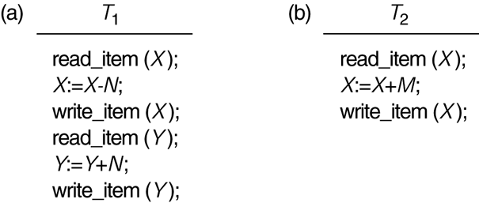
SAMPLE TRANSACTIONS
‹#›

Slide 18
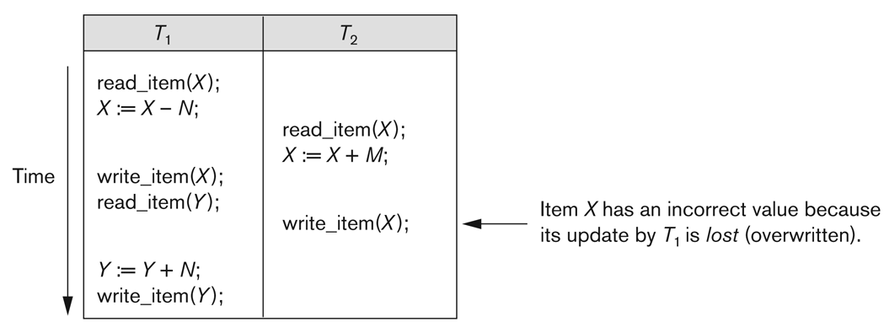
ISSUES IN TRANSACTION PROCESSING
Why Concurrency Control is needed:
The Lost Update Problem
Two transactions (that access the same DB items) have their operations interleaved in a way that makes the value of some database item incorrect.
‹#›

Slide 19
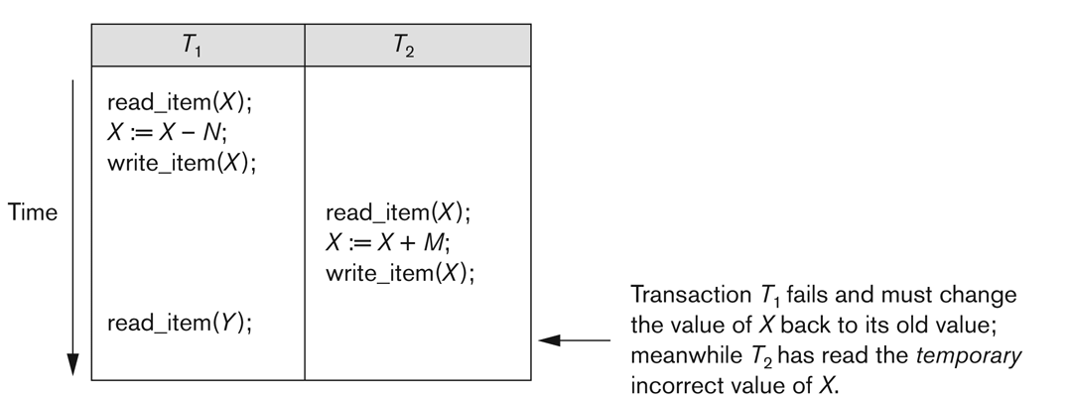
ISSUES IN TRANSACTION PROCESSING
Temporary Update (or Dirty Read) Problem
‹#›
Notes:
This occurs when one transaction updates a database item and then the transaction fails for some reason .
The updated item is accessed by another transaction before it is changed back to its original value
‹#›

Slide 20
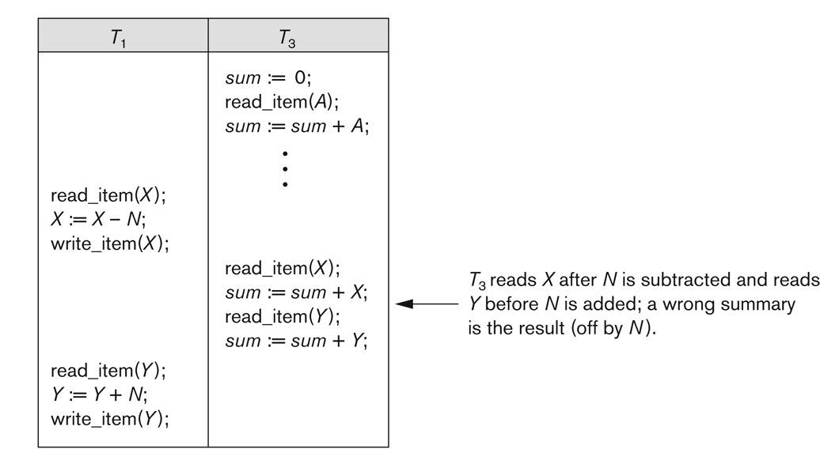
ISSUES IN TRANSACTION PROCESSING
The Incorrect Summary Problem
‹#›
Notes:
Let one transaction is calculating an aggregate summary function on a number of records
while other transactions are updating some of these records,
The aggregate function may calculate some values before they are updated and others after they are updated.
‹#›

Slide 21
TRANSACTION PROCESSING &RECOVERY
Why recovery is needed:
A computer failure (system crash):
A transaction or system error:
Integer overflow, division by zero, erroneous parameter values or the user may interrupt the transaction
Local errors or exception conditions
Data not found or
insufficient account balance may cause a fund withdrawal transaction to be canceled.
Concurrency control enforcement
Transaction violates serializability or several transactions are in a state of deadlock
Disk failure
Physical problems and catastrophes
‹#›

Slide 22
TRANSACTION AND SYSTEM CONCEPTS
A transaction is an atomic unit of work that is either completed in its entirety or not done at all.
For recovery purposes, the system needs to keep track of when the transaction starts, terminates, and commits or aborts
Transaction states:
Active state
Partially committed state
Committed state
Failed state
Terminated State
‹#›

Slide 23
TRANSACTION AND SYSTEM CONCEPTS
Recovery manager keeps track of the following operations:
begin_transaction
read or write
end_transaction
Commit
Rollback (or abort)
Undo
Similar to rollback except that it applies to a single operation rather than to a whole transaction.
Redo
‹#›
Notes:
DB now checks whether the changes made by the transaction can be
permanently applied to the database or
the transaction has to be aborted because it violates concurrency control or for some other reason.
‹#›

Slide 24
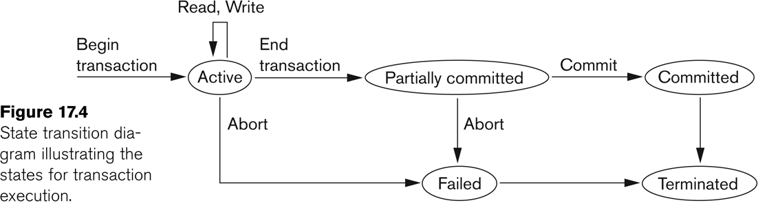
STATE TRANSITION DIAGRAM
‹#›

Slide 25
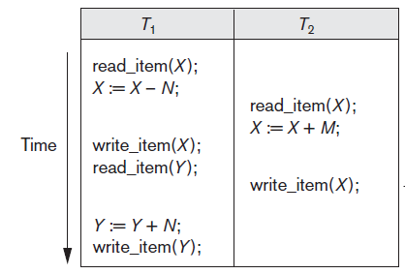
SCHEDULES
A schedule (or history) S of n transactions T1, T2, ..., Tn is an ordering of the operations of the transactions.
Operations from different transactions can be interleaved in S.
The operations of each Ti in S must appear in the same order in which they occur in Ti.
Notes:
‹#›

Slide 26
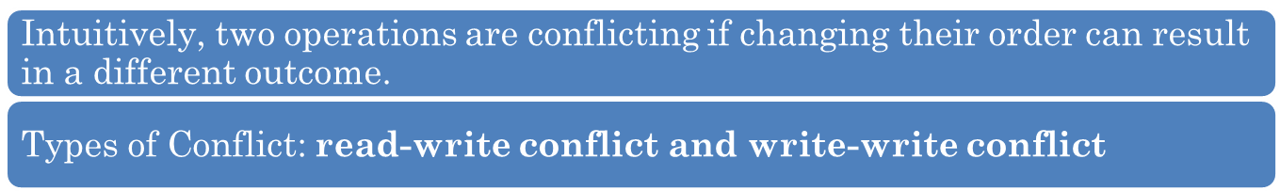
SCHEDULES
Two operations in S are in conflict if
they belong to different transactions;
they access the same item X; and
at least one of the operations is a write_item(X).
Conflicting operations
r1(X) and w2(X)
r2(X) and w1(X)
w1(X) and w2(X)
Non-conflicting operations
r1(X) and r2(X)
w2(X) and w1(Y)
r1(X) and w1(X)
Notes:
‹#›

Slide 27

CHARACTERIZING SCHEDULES BASED ON RECOVERABILITY
A schedule S is recoverable if no T in S commits until all T` that have written an item that T reads have committed.
A transaction T reads from transaction T `in S if some item X is first written by T` and later read by T.
In a recoverable schedule, no committed transaction ever needs to be rolled back
Sc non recoverable
Sd sa and se are recoverable
Notes:
‹#›
Sc non recoverable
Sd sa and se are recoverable
For some schedules it is easy to recover from transaction and system failures,
whereas for other schedules the recovery process can be quite involved. In some
cases, it is even not possible to recover correctly after a failure.Hence, it is important
to characterize the types of schedules for which recovery is possible, as well as those
for which recovery is relatively simple. These characterizations do not actually provide
the recovery algorithm; they only attempt to theoretically characterize the different
types of schedules.

Slide 28
CHARACTERIZING SCHEDULES BASED ON RECOVERABILITY (3)
Cascade rollback:
A schedule in which uncommitted transactions that read an item from a failed transaction must be rolled back.
T2 has to be rolled back because it read item X from T1, and T1 then aborted.
Notes:
‹#›
In a recoverable schedule, no committed transaction ever needs to be rolled back,
and so the definition of committed transaction as durable is not violated. However,
it is possible for a phenomenon known as cascading rollback (or cascading abort)
to occur in some recoverable schedules, where an uncommitted transaction has to be
rolled back because it read an item from a transaction that failed. This is illustrated
in schedule Se, where transaction T2 has to be rolled back because it read item X
from T1, and T1 then aborted.

Slide 29
CHARACTERIZING SCHEDULES BASED ON RECOVERABILITY
Cascadeless schedule
One where every transaction reads only the items that are written by committed transactions.
Avoid cascade rollback
The r2(X) command in schedules Sd and Se must be postponed until after T1 has committed (or aborted),
This delays T2 but ensuring no cascading rollback if T1 aborts
Notes:
‹#›

Slide 30
CHARACTERIZING SCHEDULES BASED ON RECOVERABILITY
Strict Schedules:
A schedule in which a transaction can neither read or write an item X until the last transaction that wrote X has committed.
Strict schedules simplify the recovery process.
The process of undoing a write_item(X) of an aborted transaction is to restore the before image (old_value) of X.
Sf is cascadeless, but it is not a strict schedule,
As it permits T2 to write item X even though T1 that last wrote X had not yet committed (or aborted).
Notes:
‹#›
Suppose that the value of X was originally 9, which is the before image stored in the
system log along with the w1(X, 5) operation. If T1 aborts, as in Sf , the recovery procedure
that restores the before image of an aborted write operation will restore the
value of X to 9, even though it has already been changed to 8 by transaction T2, thus
leading to potentially incorrect results.

Slide 31
It is important to note that any strict schedule is also cascadeless, and
any cascadeless schedule is also recoverable
‹#›

Slide 32
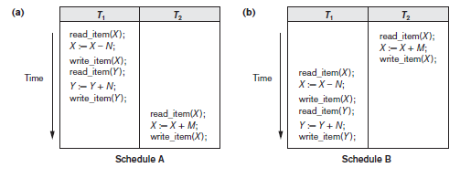
CHARACTERIZING SCHEDULES BASED ON SERIALIZABILITY
Serial schedule: A schedule S is serial if, for every T in S, all the operations of T are executed consecutively in the schedule.
Notes:
‹#›
Now we characterize the types of schedules that are always considered to
be correct when concurrent transactions are executing. Such schedules are known as
serializable schedules.
To illustrate our discussion, consider the schedules in Figure 21.5, and assume that
the initial values of database items are X = 90 and Y = 90 and that N = 3 and M = 2.
After executing transactions T1 and T2, we would expect the database values to be X
= 89 and Y = 93, according to the meaning of the transactions. Sure enough, executing
either of the serial schedules A or B gives the correct results.

Slide 33
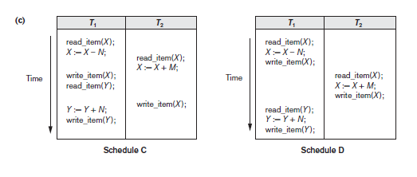
CHARACTERIZING SCHEDULES BASED ON SERIALIZABILITY
Non Serial schedule
Which one is correct ?
Schedule C gives an erroneous result because of the lost update problem
Schedule D gives correct results
Notes:
‹#›
Schedule C (which is the same as Figure 21.3(a)) gives
the results X = 92 and Y = 93, in which the X value is erroneous, whereas schedule D
gives the correct results.
Schedule C gives an erroneous result because of the lost update problem discussed in
Section 21.1.3; transaction T2 reads the value of X before it is changed by transaction
T1, so only the effect of T2 on X is reflected in the database. The effect of T1 on
X is lost, overwritten by T2, leading to the incorrect result for item X. However, some
nonserial schedules give the correct expected result, such as schedule D

Slide 34
CHARACTERIZING SCHEDULES BASED ON SERIALIZABILITY
We would like to determine which of the non-serial schedules always give a correct result and which do not .
Serializable schedule: A schedule S is serializable if it is equivalent to some serial schedule of the same n transactions.
A nonserial schedule S is serializable means it is correct,
Notes:
‹#›

Slide 35
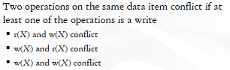
CHARACTERIZING SCHEDULES BASED ON SERIALIZABILITY
Conflict equivalent: Two schedules are said to be conflict equivalent if the order of any two conflicting operations is same in both schedules.
If two conflicting operations are applied in different orders in two schedules, the effect can be different
Notes:
‹#›

Slide 36
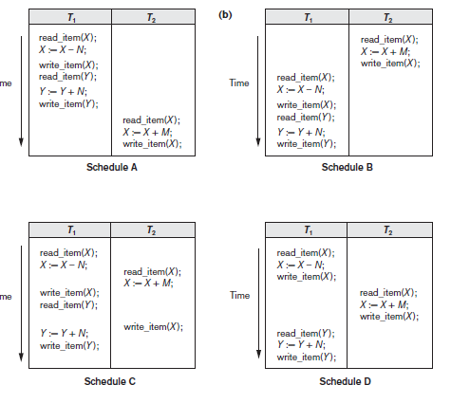
SERIALIZABILITY
A schedule S is said to be conflict serializable if it is conflict equivalent to some serial schedule S’.
Notes:
‹#›
According to this definition, schedule D in Figure 21.5(c) is equivalent
to the serial schedule A . In both schedules, the read_item(X) of T2
reads the value of X written by T1, while the other read_item operations read the
database values from the initial database state. Additionally, T1 is the last transaction
to write Y, and T2 is the last transaction to write X in both schedules. Because A is a
serial schedule and schedule D is equivalent to A, D is a serializable schedule.

Slide 37
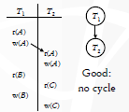
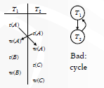
PRECEDENCE GRAPH
A node for each transaction
A directed edge from Ti to Tj if an operation of Ti precedes and conflicts with an operation of Tj in the schedule
‹#›

Slide 38
PRECEDENCE GRAPH
Testing for conflict serializability: Algorithm
For each Ti in S, create a node labeled Ti in the precedence graph.
If Tj executes a read_item(X) after Ti executes a write_item(X), create an edge (Ti→ Tj) in the precedence graph.
If Tj executes a write_item(X) after Ti executes a read_item(X), create an edge (Ti→Tj) in the precedence graph.
If Tj executes a write_item(X) after Ti executes a write_item(X), create an edge (Ti→ Tj) in the precedence graph.
The schedule S is serializable if and only if the precedence graph has no cycles..
Notes:
‹#›

Slide 39
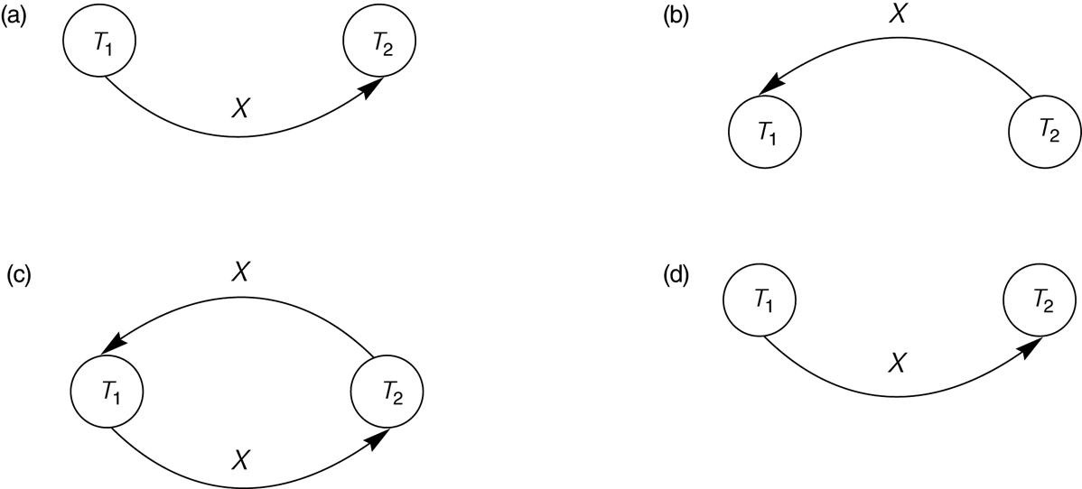
CONSTRUCTING THE PRECEDENCE GRAPHS
Notes:
‹#›

Slide 40
CONSTRUCTING THE PRECEDENCE GRAPHS
Notes:
‹#›

Slide 41
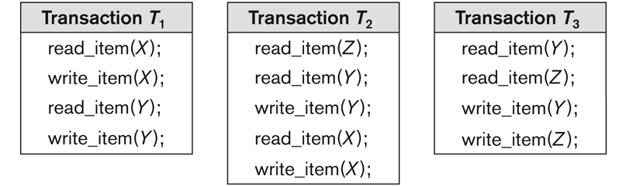
EXAMPLE OF SERIALIZABILITY TESTING
Notes:
‹#›
in general
there may be more than one equivalent serial schedule for a serializable schedule.

Slide 42
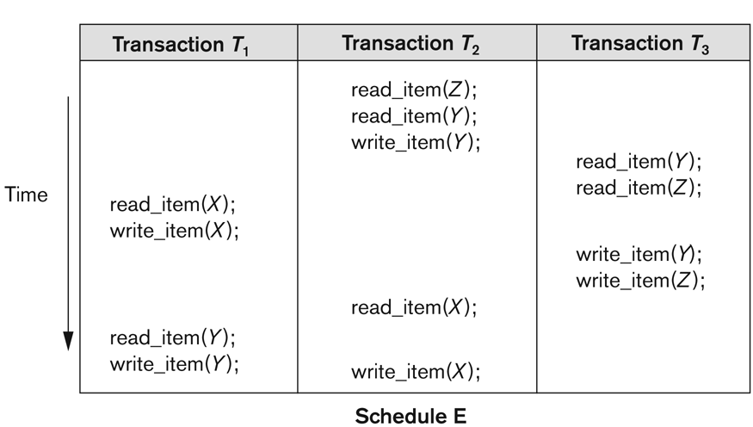
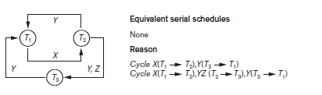
EXAMPLE OF SERIALIZABILITY TESTING
Notes:
‹#›

Slide 43
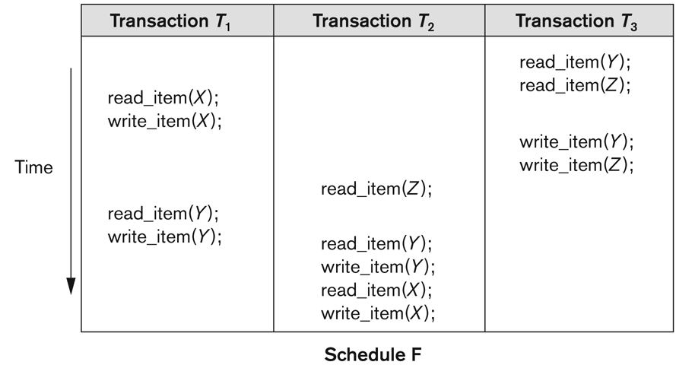
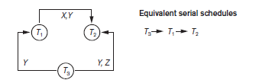
EXAMPLE OF SERIALIZABILITY TESTING
Notes:
‹#›

Slide 44
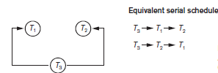
EXAMPLE OF SERIALIZABILITY TESTING
Notes:
‹#›
in general
there may be more than one equivalent serial schedule for a serializable schedule.

Slide 45
CHARACTERIZING SCHEDULES BASED ON SERIALIZABILITY
Serializability is hard to check.
Interleaving of operations occurs in an operating system through some scheduler
Difficult to determine beforehand how the operations in a schedule will be interleaved.
Notes:
‹#›

Slide 46
CHARACTERIZING SCHEDULES BASED ON SERIALIZABILITY
Come up with methods (protocols) to ensure serializability.
It’s not possible to determine when a schedule begins and when it ends.
Reduce the problem of checking the whole schedule to checking only a committed part of the schedule
(i.e. operations from only the committed transactions.)
Current approach used in most DBMSs:
Use of locks with two phase locking
Notes:
‹#›

Slide 47
TRANSACTION SUPPORT IN SQL2
A single SQL statement is always considered to be atomic.
With SQL, there is no explicit Begin Transaction statement.
Transaction initiation is done implicitly when particular SQL statements are encountered.
Every transaction must have an explicit end statement, which is either a COMMIT or ROLLBACK.
Notes:
‹#›
The diagnostic area size option, DIAGNOSTIC SIZE n, specifies an integer value n,
which indicates the number of conditions that can be held simultaneously in the
diagnostic area. These conditions supply feedback information (errors or exceptions)
to the user or program on the n most recently executed SQL statement.

Slide 48
TRANSACTION SUPPORT IN SQL2
Characteristics specified by a SET TRANSACTION statement in SQL2:
Access mode:
READ ONLY or READ WRITE.
The default is READ WRITE unless the isolation level of READ UNCOMITTED is specified, in which case READ ONLY is assumed.
Diagnostic size
specifies an integer value n, indicating the number of conditions that can be held simultaneously
These conditions supply feedback information (errors or exceptions) to the user on the n most recently executed SQL statement.
Notes:
‹#›

Slide 49
TRANSACTION SUPPORT IN SQL2
Characteristics specified by a SET TRANSACTION statement in SQL2 :
Isolation level <isolation>, where <isolation> can be READ UNCOMMITTED, READ COMMITTED, REPEATABLE READ or SERIALIZABLE. The default is SERIALIZABLE.
With SERIALIZABLE: the interleaved execution of transactions will adhere to our notion of serializability.
However, if any transaction executes at a lower level, then serializability may be violated.
Notes:
‹#›

Slide 50
TRANSACTION SUPPORT IN SQL2
Potential problem with lower isolation levels:
Dirty Read:
Reading a value that was written by a transaction which failed.
Nonrepeatable Read:
Allowing another transaction to write a new value between multiple reads of one transaction.
A transaction T1 may read a given value from a table. If another transaction T2 later updates that value and T1 reads that value again, T1 will see a different value.
Consider that T1 reads the employee salary for Smith. Next, T2 updates the salary for Smith. If T1 reads Smith's salary again, then it will see a different value for Smith's salary.
Notes:
‹#›

Slide 51
TRANSACTION SUPPORT IN SQL2
Potential problem with lower isolation levels (contd.):
Phantoms:
New rows being read using the same read with a condition.
A transaction T1 may read a set of rows from a table, perhaps based on some condition specified in the SQL WHERE clause.
Now suppose that a transaction T2 inserts a new row that also satisfies the WHERE clause condition of T1, into the table used by T1.
If T1 is repeated, then T1 will see a row that previously did not exist, called a phantom.
Notes:
‹#›

Slide 52
TRANSACTION SUPPORT IN SQL2
Sample SQL transaction:
EXEC SQL whenever sqlerror go to UNDO;
EXEC SQL SET TRANSACTION
READ WRITE
DIAGNOSTICS SIZE 5
ISOLATION LEVEL SERIALIZABLE;
EXEC SQL INSERT
INTO EMPLOYEE (FNAME, LNAME, SSN, DNO, SALARY)
VALUES ('Robert','Smith','991004321',2,35000);
EXEC SQL UPDATE EMPLOYEE
SET SALARY = SALARY * 1.1
WHERE DNO = 2;
EXEC SQL COMMIT;
GOTO THE_END;
UNDO: EXEC SQL ROLLBACK;
THE_END: ...
Notes:
‹#›

Slide 53
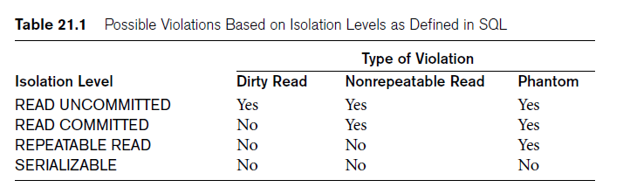
TRANSACTION SUPPORT IN SQL2
Notes:
‹#›

